Slide 1
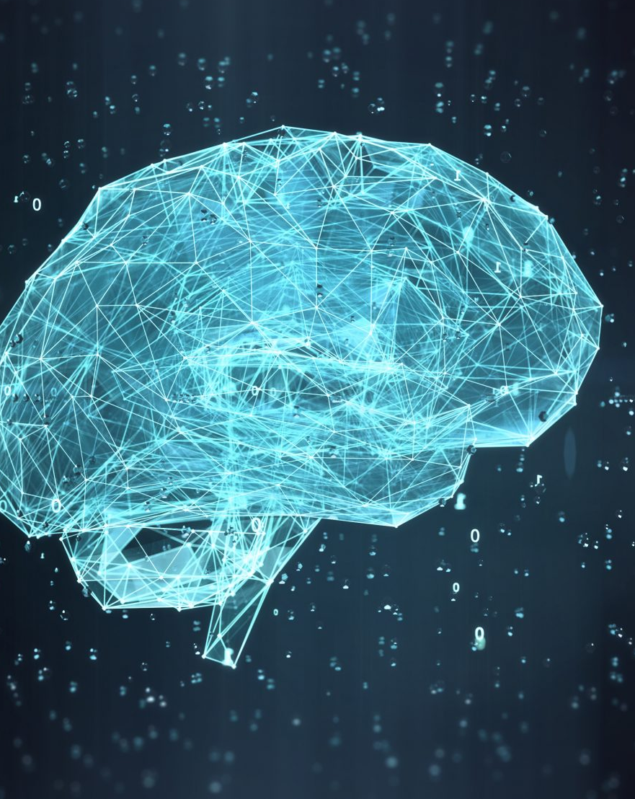
COMPETITIVE MINESWEEPER AI
TEAM Members : Morgan, Alex, Rhys, Marc, Huw

Slide 2
INDEX
PRESENTATION OF TEAM MEMBERS - SLIDE 3 - 6
HOW THE MAKEMOVE AI WORK - SLIDE 8
PICK PROBABILITY - SLIDE 9-10
RUN METHOD - SLIDE 11
UPDATE THE GAME IN MINESWEEPER - SLIDE 12
UPDATE NEIGHBOURS IN THE AI- SLIDE 13
CALCULATE PROBABILITY - SLIDE 14
DoBayes METHOD- SLIDE 15

Slide 3
MORGAN POWELL- TEAM LEADER, SCRUM MASTER,PRODUCT OWNER & DEVELOPER
What was my biggest obstacle. And how did I tackle them?
My biggest obstacle is trying to understand how an ai work and how to start the code and how to use bitbucket . which I overcome this problem by asking my teammates what is an ai? And got told it was just a java program loop from the last program. Also for bitbucket I had to practise and find fixes to the problem when to commit and fixing the program errors that prevented me from using bitbucket which been fixed.
As the Team leader, product owner. Scrum Master & developer. So for roles I changed my role every team report to give the other member the experience on being those roles and show good team play to give the team the experience on those roles, as the module leader said to us. I had to make sure the team were on deadline and making sure team had a understanding with the documents and try and annoy the team to meet the requirements. I had to do and make sure document were up-to-date
TEAM Members : Morgan, Alex, Rhys, Marc, Huw

Slide 4
ALEX -SCRUM MASTER & DEVELOPER & PRODUCT OWNER
What was my biggest obstacle. And how did I tackle them?
My biggest obstacle was to organise the team so they each had their own tasks and completed them. I overcame this problem by talking to each team member and making sure they all received a fair amount of tasks. Another obstacle was trying to read other peoples code and what they were trying to do. I overcame this by looking at what each line did and comment on that and ask team members what their code did and how it worked. From overcoming this i was able to add more code.
As SCRUM master i had to ensure everyone was assigned some tasks. This was difficult as it was difficult to communicate with other team members at times. As a developer i had to write the code. This was difficult at times as i had to read other peoples code and add my own. As a product owner i had to ensure the team knew the requirements of the AI and were on task.
TEAM Members : Morgan, Alex, Rhys, Marc, Huw

Slide 5
HUW
Team Role:
I was more involved with the early stages of the coursework. The main tasks I completed were fundamentally research into AI and various admin tasks.
The main obstacle I faced was trying to find useful information among the masses that’s available on the subject. There’s a wide array of different solutions which could have been used in order to implement this AI.
In order to overcome these challenges, I had to refer back to the specification to see exactly what the task entailed and by further understanding what was expected of us I could discern what information was useful and what wasn’t relevant to the task at hand.
TEAM Members : Morgan, Alex, Rhys, Marc, Huw

Slide 6
Marc
My role in the team
My role in the team was as a developer, I was mainly involved at the start of the start of the coursework in the scrum activity logs, where I carried out research into a number of different components of AI and the minesweeper game. Research carried out was done based of the initial planning discussion with the project leader.
Biggest obstacle
The biggest obstacle I faced was not completely understanding the code, this then prevented me from fully supporting other group members. In order to overcome this I will refer back to the class work and revise the content until I am more confident in my coding.
TEAM Members : Morgan, Alex, Rhys, Marc, Huw

Slide 7

MAKING
OF THE AI-MINESWEEPER
TEAM Members : Morgan, Alex, Rhys, Marc, Huw

Slide 8
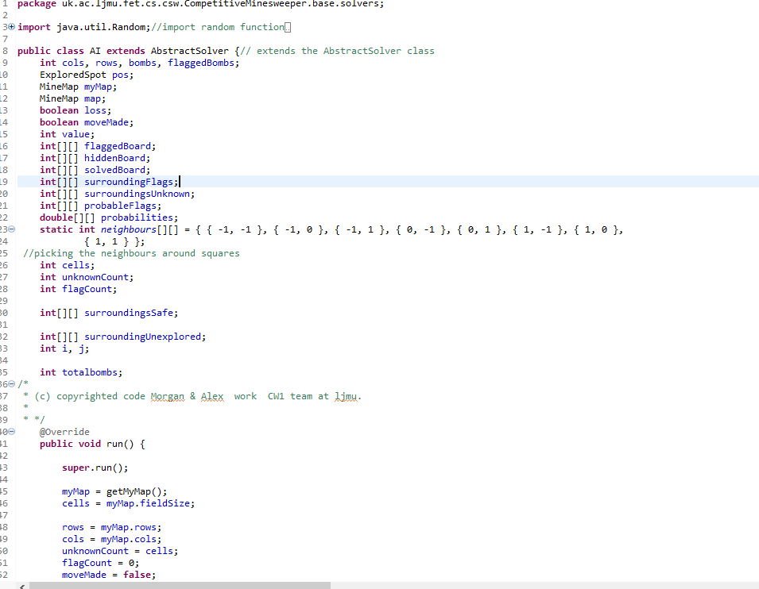
Abstract Solver
The AI class is a child to abstractsolver class which is interacting with Minmap class to make next move and in our AI class we implement methods so that abstractsolver AI class can select a next move.

Slide 9
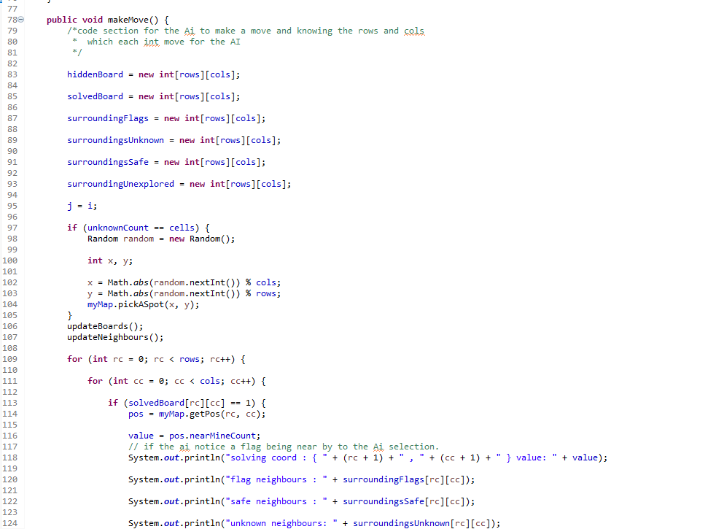
How does makeMove class work:
This class would just makeMove from based on decision from getprob and pickASpot to give the Ai to move to the next spot.
TEAM Members : Morgan, Alex, Rhys, Marc, Huw

Slide 10
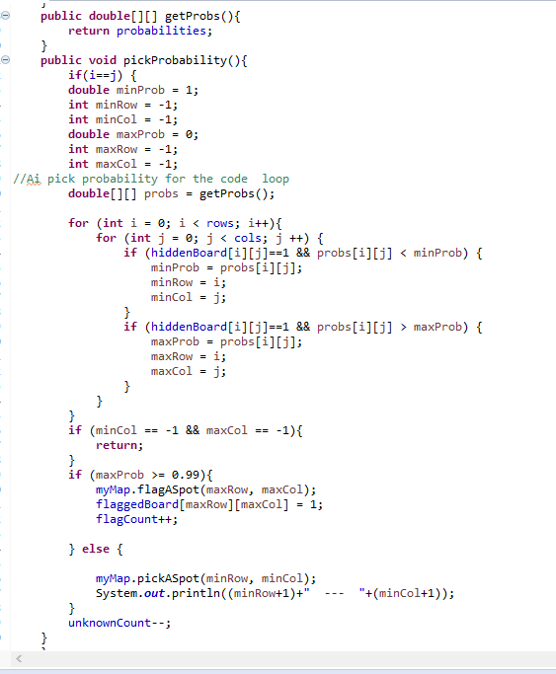
PICK PROBABILITY
The design for the PICK PROBABILITY is find the spot on a random square then selecting the unexplored neighbours of the code and return the move with the boolean made false and repeat the value on find the probability of finding a bomb,flag,number, or nothing. If it find a flag then pick a different stop if no flag found the keep on picking.Then it will go to the update probability method.
Morgan code- finding the mines, flagged, surrounding area
TEAM Members : Morgan, Alex, Rhys, Marc, Huw

Slide 11
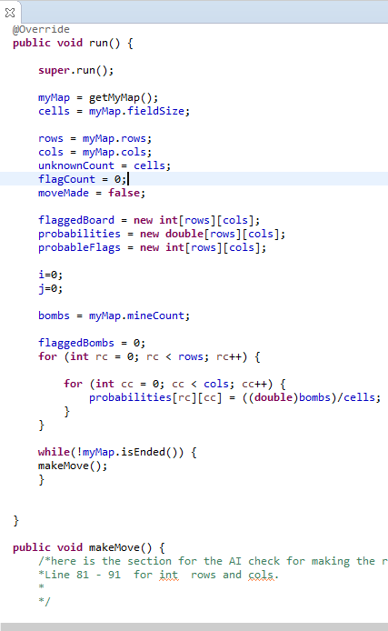
Run()
For the run method for the number of flags and bombs on the map and is ended if the Ai hit a bomb and make a move after that trigger and reset Minesweeper . It update the probability on the mapMap on where the bombs and flags be.

Slide 12
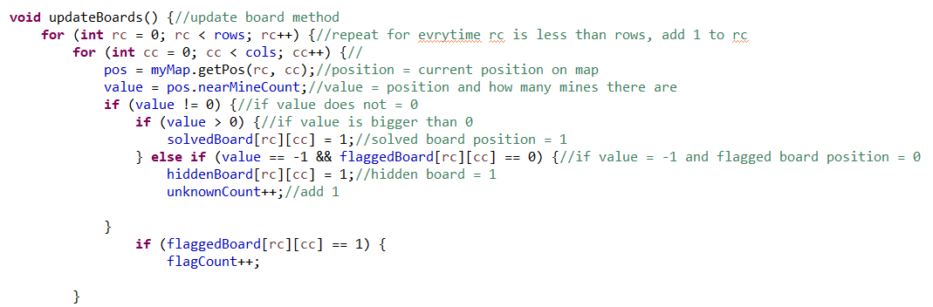
UpdateBoards, line 177+
This is used to update the board after each move.
It does this by looking at all neighbours of the current square.
It then adds to a count based on what type of square it is.
TEAM Members : Morgan, Alex, Rhys, Marc, Huw

Slide 13
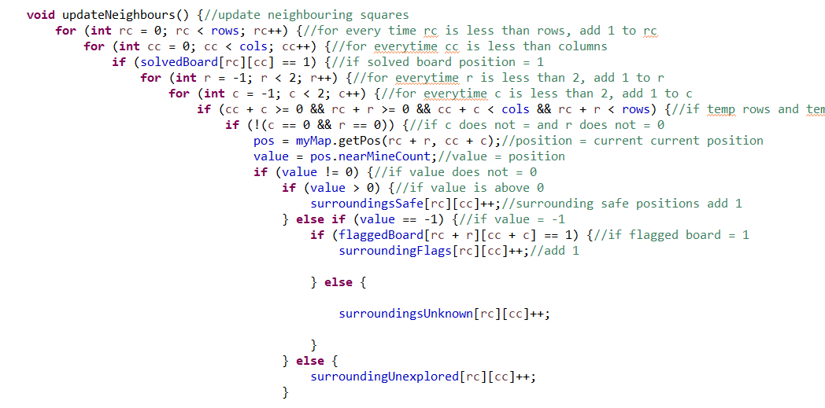
UpdateNeighbours, Line 200 +
This updates each neighbour of the current position/square after updating the boards and updating the probabilities
This works similar to the updateBoards method
It checks surrounding square types and changes the count and changes if they are discovered or not
TEAM Members : Morgan, Alex, Rhys, Marc, Huw

Slide 14
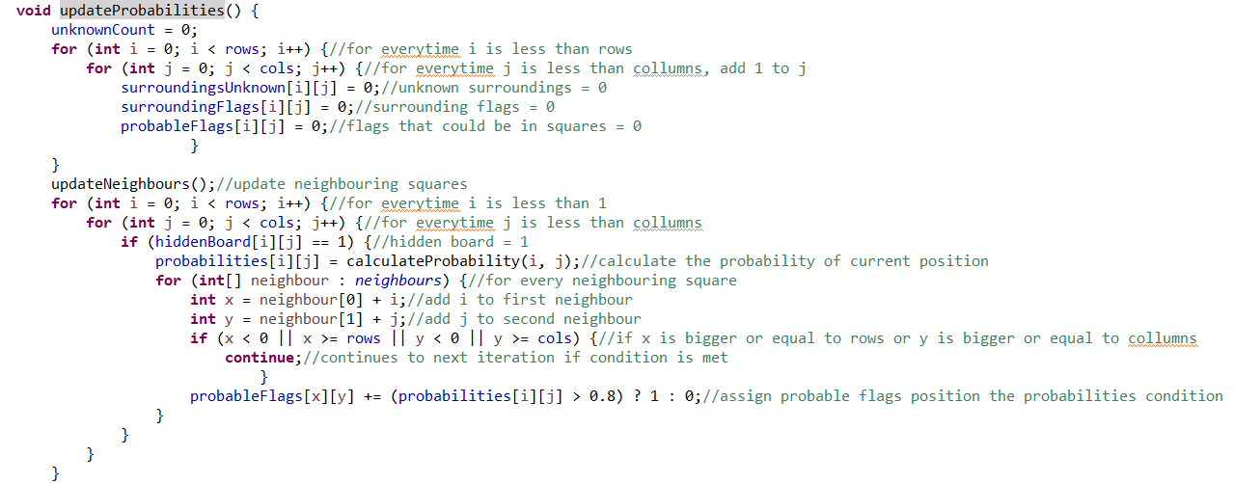
updateProbablities, line 241+
This works by looking at all the surrounding squares
Then changing each squares position to 0 so it is reset
It then uses the update neighbours method
It then calculates the probability using calculateprobability(i,j)
It then adds i and j to each neighbour
This is used to calculate where the next flags are
It then predicts the flags position in probableFlags [x][y]
This works by
TEAM Members : Morgan, Alex, Rhys, Marc, Huw

Slide 15
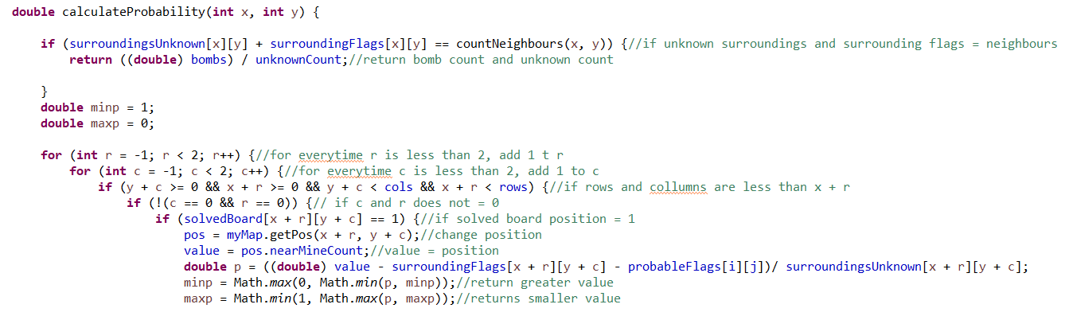
CalculateProbability, Line 329
This works by ensuring none of the surrounding squares are unknown or flags
The AI then works round each current square like in a circle by repeatedly looking at the neighbours
This works by
TEAM Members : Morgan, Alex, Rhys, Marc, Huw

Slide 16
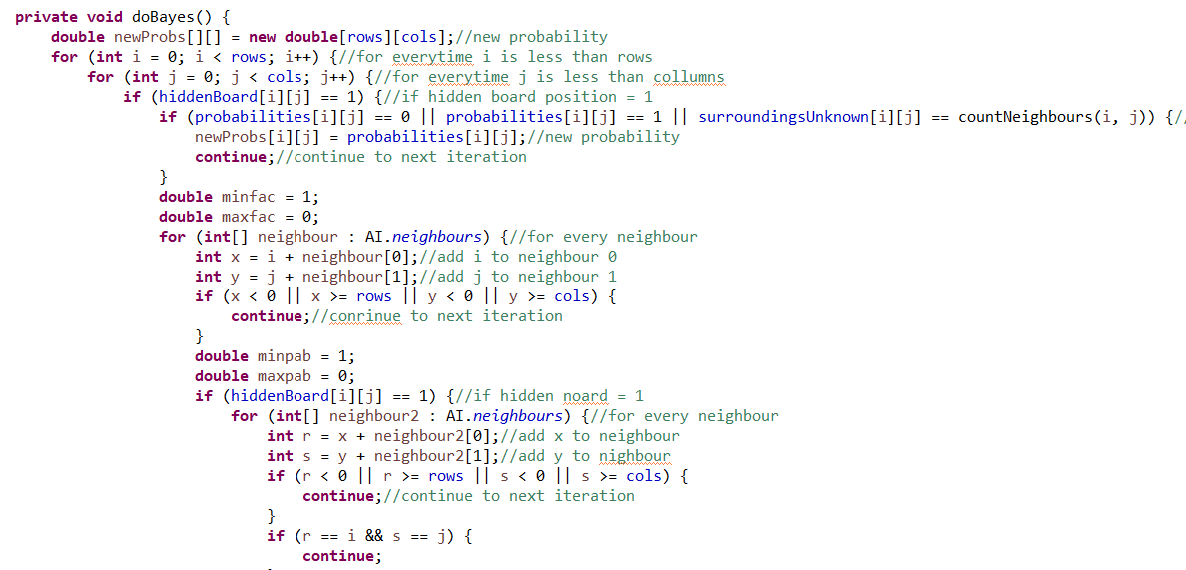
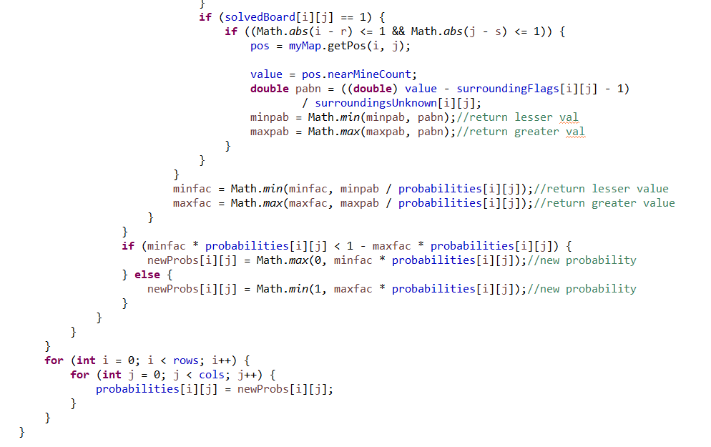
doBayes, Line 269
This works by getting a new probability and checking it against the surroundings
It gets the neighbouring squares and goes through if statements to make sure they are undiscovered or determine what they are
It calculates the probabilities from the surroundings
It then changes each of the squares that have been discovered to their type
This works by
TEAM Members : Morgan, Alex, Rhys, Marc, Huw

Slide 17
“Thank you for your time listening.”
“
TEAM Members : Morgan, Alex, Rhys, Marc, Huw

